Slide 1
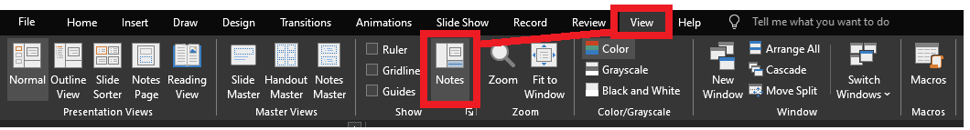
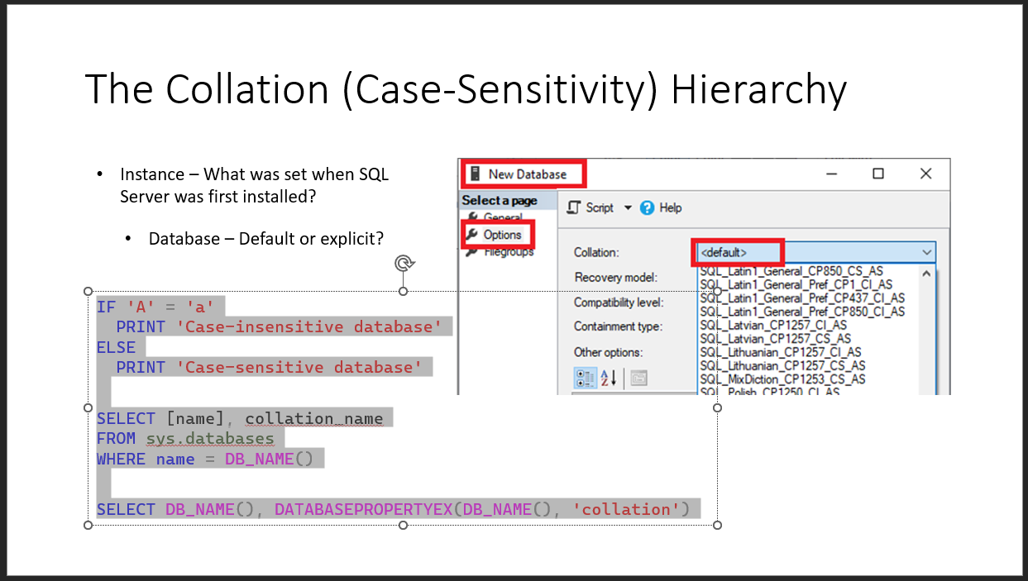
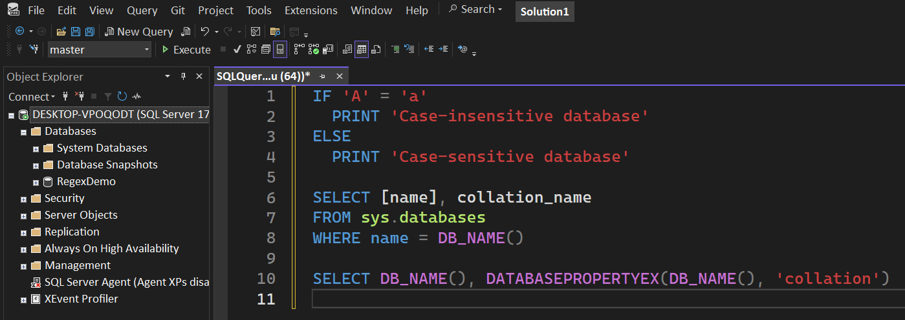
Reviewing after the presentation?
Be sure to enable the Notes for slide-specific content
Slides have working T-SQL that can be copied/pasted into SSMS

Slide 2

Advanced T-SQL Pattern Matching: Leveraging LIKE and Regular Expressions

Slide 3
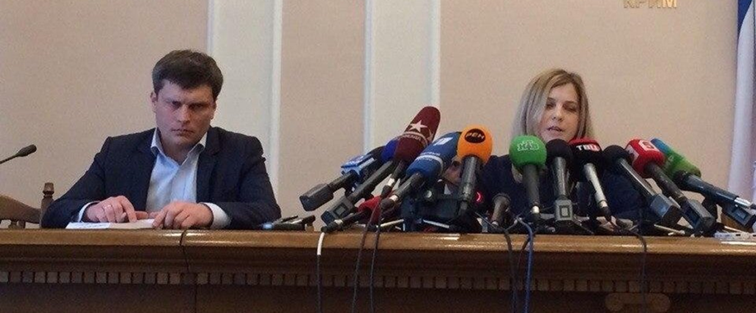
LIKE REGEXP
Notes:
Microsoft introduced Regular Expressions for Azure SQL and Fabric. You’re probably here for the brand new Regular Expressions.
But are you using LIKE effectively? Do you know all the abilities it has?
Before we go into the new shiny toy, let’s level-set on LIKE, get up-to-speed, then we can compare and contrast the REGEXP operators.

Slide 4

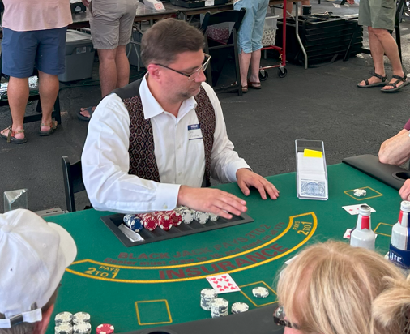



Jeff Foushee
SQL Server Database Admin
Programmer
SQL Saturday speaker
Blackjack dealer
https://www.linkedin.com/in/jeff-foushee/
https://github.com/jbfoushee/MyPresentations/

Slide 5
stringable1 LIKE stringable2
SELECT [name], [description]
FROM [SomeTable]
WHERE [description] LIKE ...
“Stringable” refers to anything that can be represented as a string, including numerics, datetimes, guids, etc.

Slide 6

%

Slide 7
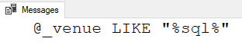
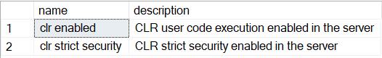
stringable1 LIKE stringable2
DECLARE @_venue varchar(20)
= 'SQL Saturday 20XX'
IF @_venue LIKE '%sql%'
PRINT '@_venue LIKE "%sql%"'
“Stringable” refers to anything that can be represented as a string, including numerics, datetimes, guids, etc.
Stringable1 is usually a longer string
Stringable2 is usually a shorter string with one/more % symbols as wildcards
SELECT [name], [description]
FROM [master].sys.configurations
WHERE [description] LIKE 'clr%'

Slide 8
% – Wildcard of any length (even zero)
WHERE Column1 LIKE '%' -- returns all non-NULL values
WHERE Column1 LIKE 'A%' -- returns values starting with A
WHERE Column1 LIKE '%A' -- returns values ending with A
WHERE Column1 LIKE 'A%B' -- returns values starting with A
and ending with B
WHERE Column1 LIKE '%B%' -- returns values containing B

Slide 9

%

Slide 10

_
[]
[-]
[^]
%
ESCAPE
Notes:
There are more symbols available to LIKE beyond the % character.
If you don’t know about them, you can’t appreciate them.

Slide 11
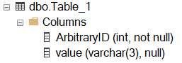
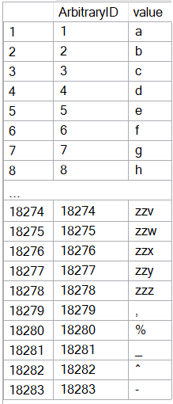
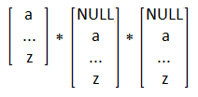
CREATE TABLE dbo.Table_1
( ArbitraryID int IDENTITY(1,1) NOT NULL, [value] varchar(3) )
SET NOCOUNT ON
DECLARE @_text2 varchar(26) = 'abcdefghijklmnopqrstuvwxyz'
DECLARE @_text1 varchar(26) = @_text2
DECLARE @_text0 varchar(26) = @_text1
DECLARE @_p2 tinyint = 0
DECLARE @_p1 tinyint = 0
DECLARE @_p0 tinyint = 0
WHILE 1 = 1
BEGIN
SET @_p2 +=1
IF @_p2 > 26
BEGIN
SET @_p1 += 1
SET @_p2 = 1
END
IF @_p1 > 26
BEGIN
SET @_p0 += 1
SET @_p1 = 1
END
IF @_p0 > 26
BREAK
DECLARE @_text varchar(3) = CONCAT(
SUBSTRING(@_text0, @_p0, 1)
, SUBSTRING(@_text1, @_p1, 1)
, SUBSTRING(@_text2, @_p2, 1) )
INSERT INTO dbo.Table_1 (value) VALUES (@_text)
END
INSERT INTO [dbo].[Table_1] ([value]) VALUES(','), ('%'), ('_'), ('^'), ('-')
INSERT INTO [dbo].[Table_1] ([value]) VALUES(','), ('%'), ('_'), ('^'), ('-')
Notes:
This code will build the sample data used for the demos

Slide 12
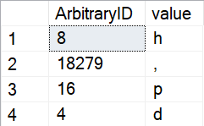
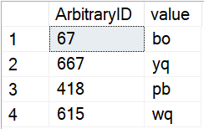
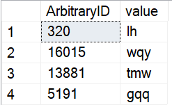
_ – Wildcard of one character (i.e. non-zero length)
SELECT TOP 4 *
FROM dbo.Table_1
WHERE Column1 LIKE '_'
ORDER BY NEWID() -- randomizer
SELECT TOP 4 *
FROM dbo.Table_1
WHERE Column1 LIKE '__'
ORDER BY NEWID() -- randomizer
SELECT TOP 4 *
FROM dbo.Table_1
WHERE Column1 LIKE '__%'
ORDER BY NEWID() -- randomizer
Notes:
The underscore guarantees a length of one character per underscore requested.

Slide 13
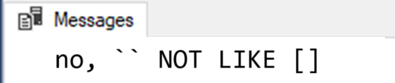
[] – Containment characters
By themselves do nothing
DECLARE @_value varchar(20) = ''
IF @_value LIKE '[]'
PRINT 'yes, `` LIKE []'
ELSE
PRINT 'no, `` NOT LIKE []'

Slide 14
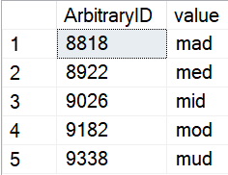
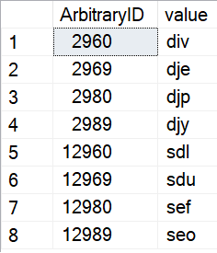
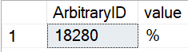
[] – Containment characters
Represent a non-delimited array of allowable characters as one position
% and _ lose their special wildcard ability inside the containment characters
NULL/blank are not acceptable entries for this list
WHERE [value] LIKE 'm[aeiou]d'
WHERE ArbitraryID LIKE '%[2%]9[86][90]'
WHERE [value] LIKE '[%]'

Slide 15
[] – Containment characters
Not nestable! [ also loses its special ability inside the containment characters
WHERE [value] LIKE '[[ab][cd]][f]'
'[[ab][cd]][f]'
What you possibly expected
af
bf
cf
df
What you asked for
“[c]f”
“ac]f”
“bc]f”
“[d]f”
...

Slide 16
Demo
● LIKE - Containment characters

Slide 17
Do I need to worry about case-sensitivity?

Slide 18
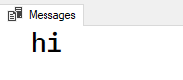
Do I need to worry about case-sensitivity?
No functions -- not even UPPER() and LOWER() -- are case-sensitive
● LIKE is affected by the current collation
IF UPPER('a') = 'a'
PRINT 'hi'
Notes:
If you run this against a case-insensitive database, you will get the following result. The UPPER function is working independently of the collation.

Slide 19
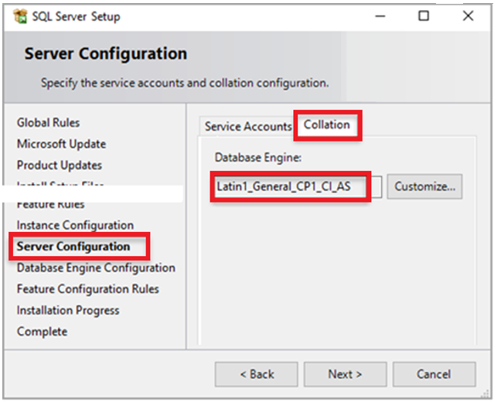
The Collation (Case-Sensitivity) Hierarchy
Instance – What was set when SQL Server was first installed?
SELECT SERVERPROPERTY('collation')
Notes:
The area CI or CS specifies if the instance will follow case-insensitive or case-sensitive collation.
The system databases will receive this collation.

Slide 20
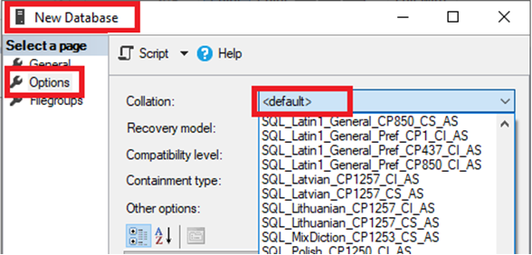
The Collation (Case-Sensitivity) Hierarchy
Instance – What was set when SQL Server was first installed?
Database – Default or explicit?
IF 'A' = 'a'
PRINT 'Case-insensitive database'
ELSE
PRINT 'Case-sensitive database'
SELECT [name], collation_name
FROM sys.databases
WHERE name = DB_NAME()
SELECT DB_NAME(), DATABASEPROPERTYEX(DB_NAME(), 'collation')
Notes:
Again, the area CI or CS specifies if the database will follow case-insensitive or case-sensitive collation

Slide 21
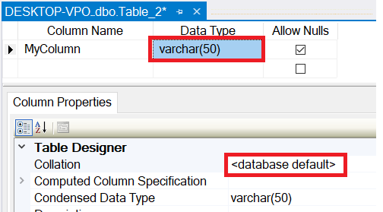
The Collation (Case-Sensitivity) Hierarchy
Instance – What was set when SQL Server was first installed?
Database – Default or explicit?
Table Column – Database default or explicit?
SELECT TABLE_SCHEMA, TABLE_NAME, COLUMN_NAME
, DATA_TYPE
, COLLATION_NAME
, CASE Convert(varchar,IsNull(COLLATION_NAME, ''))
WHEN '' THEN ''
WHEN Convert(varchar, DATABASEPROPERTYEX(DB_NAME(), 'collation')) THEN ''
ELSE '*'
END AS Not_As_DB_Collation
FROM INFORMATION_SCHEMA.COLUMNS
ORDER BY TABLE_SCHEMA, TABLE_NAME, COLUMN_NAME
Notes:
If you don’t use the database default, you are once again presented with all the collation choices.

Slide 22
The Collation (Case-Sensitivity) Hierarchy
Instance – What was set when SQL Server was first installed?
FROM Table_1 t1
INNER JOIN Table_2 t2
ON t1.SomeColumn
COLLATE
SQL_Latin1_General_CP1_CI_AS
= t2.SomeColumn
Database – Default or explicit?
FROM Table_1 t1
INNER JOIN Table_2 t2
ON t1.SomeColumn = t2.SomeColumn
Table Column – Database default or explicit?
Cannot resolve the collation conflict between "SQL_Latin1_General_CP1_CI_AS" and "Latin1_General_CI_AS" in the equal to operation.
Query-level – temporarily treat it differently for calculation purposes
Notes:
You may see this error in the following situations:
Cross-database joins
Linked-server queries
Server was installed with one collation, user database with another. Tempdb is using the same collation

Slide 23
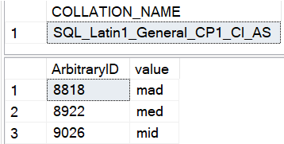
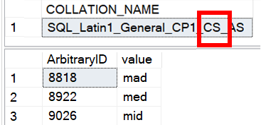
Is LIKE case-sensitive?
No functions -- not even UPPER() and LOWER() -- are case-sensitive
● LIKE is affected by the current collation
-- Request column collation
SELECT isc.COLLATION_NAME
FROM INFORMATION_SCHEMA.COLUMNS isc
WHERE isc.TABLE_NAME = 'Table_1'
AND isc.COLUMN_NAME = 'value'
-- Original query results in CAPS
SELECT t1.ArbitraryID, t1.[value]
FROM Table_1 t1
WHERE t1.[value] LIKE 'm[aei]d'
In one world...
In another world...
(lower-case)

Slide 24
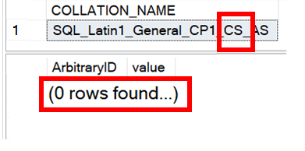
Is LIKE case-sensitive?
No functions -- not even UPPER() and LOWER() -- are case-sensitive
● LIKE is affected by the current collation
-- Request column collation
SELECT isc.COLLATION_NAME
FROM INFORMATION_SCHEMA.COLUMNS isc
WHERE isc.TABLE_NAME = 'Table_1'
AND isc.COLUMN_NAME = 'value'
-- Original query results in CAPS
SELECT t1.ArbitraryID, t1.[value]
FROM Table_1 t1
WHERE t1.[value] LIKE 'M[AEI]D'
In one world...
In another world...
(upper-case)

Slide 25
What if I need to worry about case-sensitivity?
Forcing case-sensitivity (to lower in example) on an case-insensitive column:
WHERE [CI_value] COLLATE Latin1_General_CS_AS LIKE 'm[aeiou]d'
Forcing case-insensitivity on a case-sensitive column:
WHERE [CS_value] COLLATE Latin1_General_CI_AS LIKE 'm[aeiou]d'
WHERE [CS_value] LIKE '[mM][aAeEiIoOuU][dD]'
WHERE LOWER([CS_value]) LIKE 'm[aeiou]d'
Notes:
If you plan to use these types of queries often, you might consider building a persisted computed column to speed up finding these results. You can index a computed column.

Slide 26
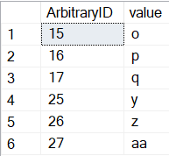
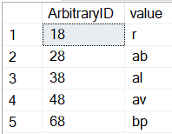
[-] – Range character
Provides a shortcut to consolidate characters on its immediate left and right
Characters must be contiguous; Lower value must be on the left.
WHERE [ArbitraryID] LIKE '[1-2][5-7]'
WHERE [ArbitraryID] LIKE '[1-46]8'
1 5
2 6
7
1
2
3 8
4
6

Slide 27
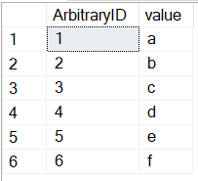
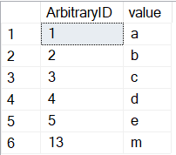
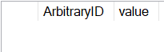
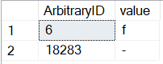
[-] – Range character
Provides a shortcut to consolidate characters on its immediate left and right
Characters must be contiguous; Lower value must be on the left.
WHERE [value] LIKE '[a-f]'
WHERE [value] LIKE '[a-em]'
WHERE [value] LIKE '[f-a]'
WHERE [value] LIKE '[-f]'

Slide 28
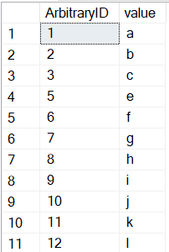
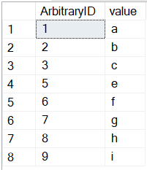

[^] – Negation character
Provides a “NOT” to all characters on its right
Must be the FIRST character within the containment characters to take effect
WHERE [ArbitraryID] LIKE '[^4]'
WHERE [ArbitraryID] NOT LIKE '[4]'

Slide 29
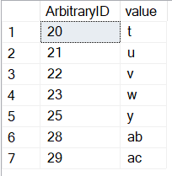
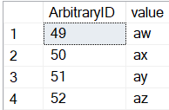
[^] – Negation character
Provides a “NOT” to all characters on its right
Must be the FIRST character within the containment characters to take effect
WHERE [ArbitraryID] LIKE '2[^467]'
WHERE [value] LIKE 'a[^a-v]'

Slide 30
Demo
● LIKE - Range and negation

Slide 31
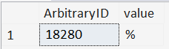
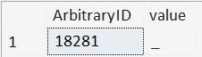
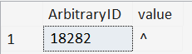
ESCAPE stringable
WHERE [value] LIKE '%\%%' ESCAPE '\'
WHERE [value] LIKE '%%' ESCAPE '%'
WHERE [value] LIKE '%!_%' ESCAPE '!'
WHERE [value] LIKE '%2^%' ESCAPE 2

Slide 32
CASE/WHEN/THEN[/ELSE]/END
Allows conditional logic within queries, enabling different outputs based on specified conditions
SELECT Phone_Number
, CASE WHEN Phone_Number LIKE
'[0-9][0-9][0-9]-[0-9][0-9][0-9]-[0-9][0-9][0-9][0-9]'
THEN '(Valid)'
ELSE ''
END AS isValid
FROM dbo.Employees
Correct syntax
SELECT Phone_Number
, CASE Phone_Number
WHEN LIKE '[0-9][0-9][0-9]-[0-9][0-9][0-9]-...'
THEN '(Valid)'
ELSE ''
END AS isValid
FROM dbo.Employees
Incorrect syntax
Notes:
LIKE is available in the CASE/WHEN/THEN/ELSE/END phrase, but requires a special syntax placement

Slide 33
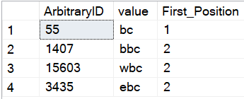
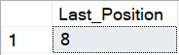
PATINDEX(like_pattern, stringable)
Returns the starting position of the first occurrence of a pattern in a specified expression, or zero if the pattern is not found, on all valid text and character data types.
SELECT TOP 4 ArbitraryID
, [value]
, PATINDEX('%bc', [value]) AS [First_Position]
FROM dbo.Table_1
WHERE [value] LIKE '%bc'
ORDER BY NEWID()
--Find the "last position" using REVERSE()
DECLARE @_value varchar(20) = 'abcdefabcg'
SELECT LEN(@_value)
- PATINDEX(REVERSE('%bc%'), REVERSE(@_value))
AS [Last_Position]

Slide 34
So, like, any questions on LIKE?
Next up, REGEXP_<> functions…
● REGEXP_COUNT()
● REGEXP_LIKE()
● REGEXP_INSTR()
● REGEXP_REPLACE()
● REGEXP_SUBSTR()

Slide 35

Notes:
Regular Expressions is over 70 years old.

Slide 36










Python
JavaScript
Java
C#.NET
Perl
php
Ruby
MySQL
PostgreSQL
Azure SQL DB
Notes:
What is old is new again.

Slide 37



Should I switch to RegEx?
Do I have a compelling reason to switch to RegEx?
WHERE REGEXP_LIKE
(Email,'^[A-Za-z0-9._%+-]+@[A-Za-z0-9.-]+\.[A-Za-z]{2,}$')
WHERE Email LIKE '%@%.%'
Notes:
Is this to satisfy a problem that LIKE can’t solve?
Am I ensuring people get critical messages about operational uptime? Or this week’s favorite recipes?

Slide 38
Should I switch to RegEx?
Do I have time to learn this complex scripting language?
Notes:
Unfortunately, I won’t be able to teach you everything in one hour, and your payoff may not be immediate.

Slide 39
Should I switch to RegEx?
Do I understand RegEx well enough to write in it?
Do I understand all the business rules well enough to (re-)write them in RegEx?

Slide 40



Should I switch to RegEx?
Which of my teammates can troubleshoot RegEx if I write it?
Office Space, 1999

Slide 41
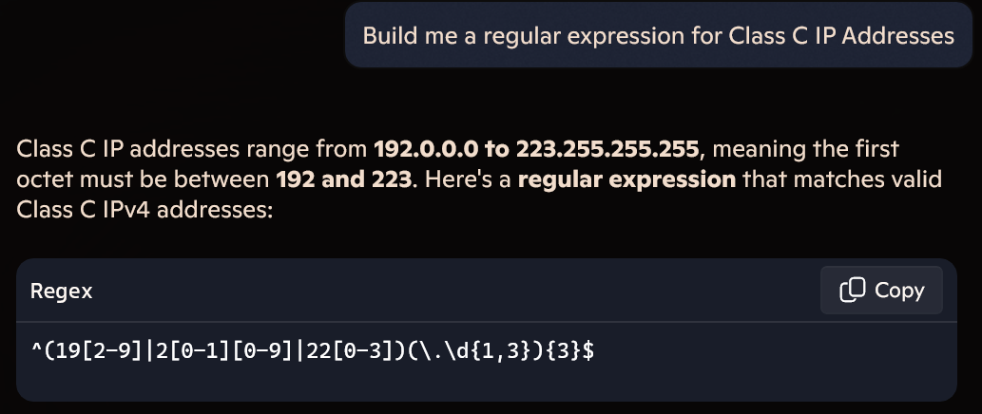
Should I switch to RegEx?
Can I steal a RegEx pattern from the Internet (search or Generative AI)?
Notes:
Generative AI can quickly give a slam-dunk Regex pattern to certain problems.

Slide 42
Should I switch to RegEx?
Can I steal a RegEx pattern from the Internet (search or Generative AI)?
Regular Expression pattern for email address:
^\S+@\S+\.\S+$
^[a-zA-Z0-9_.+-]+@[a-zA-Z0-9-]+\.[a-zA-Z0-9-.]+$
^\w+([-+.']\w+)*@\w+([-.]\w+)*\.\w+([-.]\w+)*$
Notes:
However, in other cases, not even the Internet agrees on an iron-clad solution to a pattern

Slide 43
Mail::RFC822::Address: RegExp-based address validation
(?:(?:\r\n)?[ \t])*(?:(?:(?:[^()<>@,;:\\".\[\] \000-\031]+(?:(?:(?:\r\n)?[ \t])+|\Z|(?=[\["()<>@,;:\\".\[\]]))|"(?:[^\"\r\\]|\\.|(?:(?:\r\n)?[ \t]))*"(?:(?:\r\n)?[ \t])*)(?:\.(?:(?:\r\n)?[ \t])*(?:[^()<>@,;:\\".\[\] \000-\031]+(?:(?:(?:\r\n)?[ \t])+|\Z|(?=[\["()<>@,;:\\".\[\]]))|"(?:[^\"\r\\]|\\.|(?:(?:\r\n)?[\t]))*"(?:(?:\r\n)?[ \t])*))*@(?:(?:\r\n)?[ \t])*(?:[^()<>@,;:\\".\[\] \000-\031]+(?:(?:(?:\r\n)?[ \t])+|\Z|(?=[\["()<>@,;:\\".\[\]]))|\[([^\[\]\r\\]|\\.)*\](?:(?:\r\n)?[ \t])*)(?:\.(?:(?:\r\n)?[ \t])*(?:[^()<>@,;:\\".\[\] \000-\031]+(?:(?:(?:\r\n)?[ \t])+|\Z|(?=[\["()<>@,;:\\".\[\]]))|\[([^\[\]\r\\]|\\.)*\](?:(?:\r\n)?[ \t])*))*|(?:[^()<>@,;:\\".\[\] \000-\031]+(?:(?:(?:\r\n)?[ \t])+|\Z|(?=[\["()<>@,;:\\".\[\]]))|"(?:[^\"\r\\]|\\.|(?:(?:\r\n)?[ \t]))*"(?:(?:\r\n)?[ \t])*)*\<(?:(?:\r\n)?[ \t])*(?:@(?:[^()<>@,;:\\".\[\] \000-\031]+(?:(?:(?:\r\n)?[ \t])+|\Z|(?=[\["()<>@,;:\\".\[\]]))|\[([^\[\]\r\\]|\\.)*\](?:(?:\r\n)?[ \t])*)(?:\.(?:(?:\r\n)?[ \t])*(?:[^()<>@,;:\\".\[\] \000-\031]+(?:(?:(?:\r\n)?[ \t])+|\Z|(?=[\["()<>@,;:\\".\[\]]))|\[([^\[\]\r\\]|\\.)*\](?:(?:\r\n)?[ \t])*))*(?:,@(?:(?:\r\n)?[ \t])*(?:[^()<>@,;:\\".\[\] \000-\031]+(?:(?:(?:\r\n)?[ \t])+|\Z|(?=[\["()<>@,;:\\".\[\]]))|\[([^\[\]\r\\]|\\.)*\](?:(?:\r\n)?[ \t])*)(?:\.(?:(?:\r\n)?[ \t])*(?:[^()<>@,;:\\".\[\] \000-\031]+(?:(?:(?:\r\n)?[ \t])+|\Z|(?=[\["()<>@,;:\\".\[\]]))|\[([^\[\]\r\\]|\\.)*\](?:(?:\r\n)?[ \t])*))*)*:(?:(?:\r\n)?[ \t])*)?(?:[^()<>@,;:\\".\[\] \000-\031]+(?:(?:(?:\r\n)?[ \t])+|\Z|(?=[\["()<>@,;:\\".\[\]]))|"(?:[^\"\r\\]|\\.|(?:(?:\r\n)?[ \t]))*"(?:(?:\r\n)?[ \t])*)(?:\.(?:(?:\r\n)?[ \t])*(?:[^()<>@,;:\\".\[\] \000-\031]+(?:(?:(?:\r\n)?[ \t])+|\Z|(?=[\["()<>@,;:\\".\[\]]))|"(?:[^\"\r\\]|\\.|(?:(?:\r\n)?[ \t]))*"(?:(?:\r\n)?[ \t])*))*@(?:(?:\r\n)?[ \t])*(?:[^()<>@,;:\\".\[\] \000-\031]+(?:(?:(?:\r\n)?[ \t])+|\Z|(?=[\["()<>@,;:\\".\[\]]))|\[([^\[\]\r\\]|\\.)*\](?:(?:\r\n)?[ \t])*)(?:\.(?:(?:\r\n)?[ \t])*(?:[^()<>@,;:\\".\[\] \000-\031]+(?:(?:(?:\r\n)?[ \t])+|\Z|(?=[\["()<>@,;:\\".\[\]]))|\[([^\[\]\r\\]|\\.)*\](?:(?:\r\n)?[ \t])*))*\>(?:(?:\r\n)?[ \t])*)|(?:[^()<>@,;:\\".\[\] \000-\031]+(?:(?:(?:\r\n)?[ \t])+|\Z|(?=[\["()<>@,;:\\".\[\]]))|"(?:[^\"\r\\]|\\.|(?:(?:\r\n)?[ \t]))*"(?:(?:\r\n)?[ \t])*)*:(?:(?:\r\n)?[ \t])*(?:(?:(?:[^()<>@,;:\\".\[\] \000-\031]+(?:(?:(?:\r\n)?[ \t])+|\Z|(?=[\["()<>@,;:\\".\[\]]))|"(?:[^\"\r\\]|\\.|(?:(?:\r\n)?[ \t]))*"(?:(?:\r\n)?[ \t])*)(?:\.(?:(?:\r\n)?[ \t])*(?:[^()<>@,;:\\".\[\] \000-\031]+(?:(?:(?:\r\n)?[ \t])+|\Z|(?=[\["()<>@,;:\\".\[\]]))|"(?:[^\"\r\\]|\\.|(?:(?:\r\n)?[ \t]))*"(?:(?:\r\n)?[ \t])*))*@(?:(?:\r\n)?[ \t])*(?:[^()<>@,;:\\".\[\] \000-\031]+(?:(?:(?:\r\n)?[ \t])+|\Z|(?=[\["()<>@,;:\\".\[\]]))|\[([^\[\]\r\\]|\\.)*\](?:(?:\r\n)?[ \t])*)(?:\.(?:(?:\r\n)?[ \t])*(?:[^()<>@,;:\\".\[\] \000-\031]+(?:(?:(?:\r\n)?[ \t])+|\Z|(?=[\["()<>@,;:\\".\[\]]))|\[([^\[\]\r\\]|\\.)*\](?:(?:\r\n)?[ \t])*))*|(?:[^()<>@,;:\\".\[\] \000-\031]+(?:(?:(?:\r\n)?[ \t])+|\Z|(?=[\["()<>@,;:\\".\[\]]))|"(?:[^\"\r\\]|\\.|(?:(?:\r\n)?[ \t]))*"(?:(?:\r\n)?[ \t])*)*\<(?:(?:\r\n)?[ \t])*(?:@(?:[^()<>@,;:\\".\[\] \000-\031]+(?:(?:(?:\r\n)?[ \t])+|\Z|(?=[\["()<>@,;:\\".\[\]]))|\[([^\[\]\r\\]|\\.)*\](?:(?:\r\n)?[ \t])*)(?:\.(?:(?:\r\n)?[ \t])*(?:[^()<>@,;:\\".\[\] \000-\031]+(?:(?:(?:\r\n)?[ \t])+|\Z|(?=[\["()<>@,;:\\".\[\]]))|\[([^\[\]\r\\]|\\.)*\](?:(?:\r\n)?[ \t])*))*(?:,@(?:(?:\r\n)?[ \t])*(?:[^()<>@,;:\\".\[\] \000-\031]+(?:(?:(?:\r\n)?[ \t])+|\Z|(?=[\["()<>@,;:\\".\[\]]))|\[([^\[\]\r\\]|\\.)*\](?:(?:\r\n)?[ \t])*)(?:\.(?:(?:\r\n)?[ \t])*(?:[^()<>@,;:\\".\[\] \000-\031]+(?:(?:(?:\r\n)?[ \t])+|\Z|(?=[\["()<>@,;:\\".\[\]]))|\[([^\[\]\r\\]|\\.)*\](?:(?:\r\n)?[ \t])*))*)*:(?:(?:\r\n)?[ \t])*)?(?:[^()<>@,;:\\".\[\] \000-\031]+(?:(?:(?:\r\n)?[ \t])+|\Z|(?=[\["()<>@,;:\\".\[\]]))|"(?:[^\"\r\\]|\\.|(?:(?:\r\n)?[ \t]))*"(?:(?:\r\n)?[ \t])*)(?:\.(?:(?:\r\n)?[ \t])*(?:[^()<>@,;:\\".\[\] \000-\031]+(?:(?:(?:\r\n)?[ \t])+|\Z|(?=[\["()<>@,;:\\".\[\]]))|"(?:[^\"\r\\]|\\.|(?:(?:\r\n)?[ \t]))*"(?:(?:\r\n)?[ \t])*))*@(?:(?:\r\n)?[ \t])*(?:[^()<>@,;:\\".\[\] \000-\031]+(?:(?:(?:\r\n)?[ \t])+|\Z|(?=[\["()<>@,;:\\".\[\]]))|\[([^\[\]\r\\]|\\.)*\](?:(?:\r\n)?[ \t])*)(?:\.(?:(?:\r\n)?[ \t])*(?:[^()<>@,;:\\".\[\] \000-\031]+(?:(?:(?:\r\n)?[ \t])+|\Z|(?=[\["()<>@,;:\\".\[\]]))|\[([^\[\]\r\\]|\\.)*\](?:(?:\r\n)?[ \t])*))*\>(?:(?:\r\n)?[ \t])*)(?:,\s*(?:(?:[^()<>@,;:\\".\[\] \000-\031]+(?:(?:(?:\r\n)?[ \t])+|\Z|(?=[\["()<>@,;:\\".\[\]]))|"(?:[^\"\r\\]|\\.|(?:(?:\r\n)?[ \t]))*"(?:(?:\r\n)?[ \t])*)(?:\.(?:(?:\r\n)?[ \t])*(?:[^()<>@,;:\\".\[\] \000-\031]+(?:(?:(?:\r\n)?[ \t])+|\Z|(?=[\["()<>@,;:\\".\[\]]))|"(?:[^\"\r\\]|\\.|(?:(?:\r\n)?[ \t]))*"(?:(?:\r\n)?[ \t])*))*@(?:(?:\r\n)?[ \t])*(?:[^()<>@,;:\\".\[\] \000-\031]+(?:(?:(?:\r\n)?[ \t])+|\Z|(?=[\["()<>@,;:\\".\[\]]))|\[([^\[\]\r\\]|\\.)*\](?:(?:\r\n)?[ \t])*)(?:\.(?:(?:\r\n)?[ \t])*(?:[^()<>@,;:\\".\[\] \000-\031]+(?:(?:(?:\r\n)?[ \t])+|\Z|(?=[\["()<>@,;:\\".\[\]]))|\[([^\[\]\r\\]|\\.)*\](?:(?:\r\n)?[ \t])*))*|(?:[^()<>@,;:\\".\[\] \000-\031]+(?:(?:(?:\r\n)?[ \t])+|\Z|(?=[\["()<>@,;:\\".\[\]]))|"(?:[^\"\r\\]|\\.|(?:(?:\r\n)?[ \t]))*"(?:(?:\r\n)?[ \t])*)*\<(?:(?:\r\n)?[ \t])*(?:@(?:[^()<>@,;:\\".\[\] \000-\031]+(?:(?:(?:\r\n)?[ \t])+|\Z|(?=[\["()<>@,;:\\".\[\]]))|\[([^\[\]\r\\]|\\.)*\](?:(?:\r\n)?[ \t])*)(?:\.(?:(?:\r\n)?[ \t])*(?:[^()<>@,;:\\".\[\] \000-\031]+(?:(?:(?:\r\n)?[ \t])+|\Z|(?=[\["()<>@,;:\\".\[\]]))|\[([^\[\]\r\\]|\\.)*\](?:(?:\r\n)?[ \t])*))*(?:,@(?:(?:\r\n)?[ \t])*(?:[^()<>@,;:\\".\[\] \000-\031]+(?:(?:(?:\r\n)?[ \t])+|\Z|(?=[\["()<>@,;:\\".\[\]]))|\[([^\[\]\r\\]|\\.)*\](?:(?:\r\n)?[ \t])*)(?:\.(?:(?:\r\n)?[ \t])*(?:[^()<>@,;:\\".\[\] \000-\031]+(?:(?:(?:\r\n)?[ \t])+|\Z|(?=[\["()<>@,;:\\".\[\]]))|\[([^\[\]\r\\]|\\.)*\](?:(?:\r\n)?[ \t])*))*)*:(?:(?:\r\n)?[ \t])*)?(?:[^()<>@,;:\\".\[\] \000-\031]+(?:(?:(?:\r\n)?[ \t])+|\Z|(?=[\["()<>@,;:\\".\[\]]))|"(?:[^\"\r\\]|\\.|(?:(?:\r\n)?[ \t]))*"(?:(?:\r\n)?[ \t])*)(?:\.(?:(?:\r\n)?[ \t])*(?:[^()<>@,;:\\".\[\] \000-\031]+(?:(?:(?:\r\n)?[ \t])+|\Z|(?=[\["()<>@,;:\\".\[\]]))|"(?:[^\"\r\\]|\\.|(?:(?:\r\n)?[ \t]))*"(?:(?:\r\n)?[ \t])*))*@(?:(?:\r\n)?[ \t])*(?:[^()<>@,;:\\".\[\] \000-\031]+(?:(?:(?:\r\n)?[ \t])+|\Z|(?=[\["()<>@,;:\\".\[\]]))|\[([^\[\]\r\\]|\\.)*\](?:(?:\r\n)?[ \t])*)(?:\.(?:(?:\r\n)?[ \t])*(?:[^()<>@,;:\\".\[\] \000-\031]+(?:(?:(?:\r\n)?[ \t])+|\Z|(?=[\["()<>@,;:\\".\[\]]))|\[([^\[\]\r\\]|\\.)*\](?:(?:\r\n)?[ \t])*))*\>(?:(?:\r\n)?[ \t])*))*)?;\s*)
6342 characters
https://pdw.ex-parrot.com/Mail-RFC822-Address.html
Notes:
Or the pattern is so ridiculous that it’s not maintainable.

Slide 44
Should I switch to RegEx?
Can I steal a RegEx pattern from the Internet (search or Generative AI)?
(Does the Internet agree on a pattern?)

Slide 45
Additional points?

Slide 46

Key Differences between LIKE and REGEXP_<>
A default LIKE search matches the sensitivity of the database collation
(We discussed this earlier)
A default REGEXP_<> search is case-sensitive,
irrespective of database collation

Slide 47
Key Differences between LIKE and REGEXP_<>
The pattern provided to LIKE implies beginning, middle, end, and length based on the characters given to it
mad
med
mid
mod
mud
WHERE [value] LIKE 'm[aeiou]d'
Implied start Implied end

Slide 48

Key Differences between LIKE and REGEXP_<>
The pattern provided to REGEXP_<> is allowed to appear anywhere in the string to match. Additional directives are applied to specify beginning and end of string.
1. WHERE REGEXP_LIKE([value], 'm[aeiou]d')
2. WHERE REGEXP_LIKE([value], '^m[aeiou]d')
3. WHERE REGEXP_LIKE([value], 'm[aeiou]d$')
+
(Start-of-text character)
(End-of-text character)

Slide 49
Key Differences between LIKE and REGEXP_<>
The pattern provided to REGEXP_<> is allowed to appear anywhere in the string to match. Additional directives are applied to specify beginning and end of string.
Clause 1 | Clause 2 | Clause 3
m[aeiou]d | ^m[aeiou]d | m[aeiou]d$
mad | mad | mad
maddening | maddening | maddening
med | med | med
mid | mid | mid
mod | mod | mod
mud | mud | mud
nomad | nomad | nomad
1. WHERE REGEXP_LIKE([value], 'm[aeiou]d')
2. WHERE REGEXP_LIKE([value], '^m[aeiou]d')
3. WHERE REGEXP_LIKE([value], 'm[aeiou]d$')

Slide 50
The similarities…
Pattern | LIKE | REGEXP
Any one character from a selection | [abc] | [abc]
Any character not in the selection | [^abc] | [^abc]
Any one character in the range | [a-g] | [a-g]
Any numeric in the range | [1-4] | [1-4]

Slide 51
Some transcribed syntax for characters…
Pattern | LIKE | REGEXP
Exactly 1 character (ignoring \n) | _ | .
 |  | .{1}
Any 0+ characters (ignoring \n) | % | .*
 |  | .{0,}
Any 1+ characters (ignoring \n) | _% | .+
 |  | .{1,}
Escaping a symbol | '!_' ESCAPE '!' | \.
“Quantifiers”

Slide 52
Some transcribed syntax for numerics…
Pattern | LIKE | REGEXP
Exactly 1 numeric | [0-9] | [0-9]
 |  | [0-9]{1}
 |  | \d{1}
Any 0+ numerics | n/a | [0-9]*
 |  | [0-9]{0,}
 |  | \d*
 |  | \d{0,}
Any 1+ numerics | n/a | [0-9]+
 |  | [0-9]{1,}
 |  | \d+
 |  | \d{1,}
“Metacharacters”

Slide 53
Too complex for LIKE…
Pattern | LIKE | REGEXP
Exactly n numeric characters |  | [0-9]{n}
At least n numeric characters |  | [0-9]{n,}
Between n and m numeric characters |  | [0-9]{n,m}
Any one phrase from a selection |  | (oh|on)
Any one phrase, repeated n times |  | (oh|on){n}
Either zero or one lowercase letter |  | [a-z]?

Slide 54
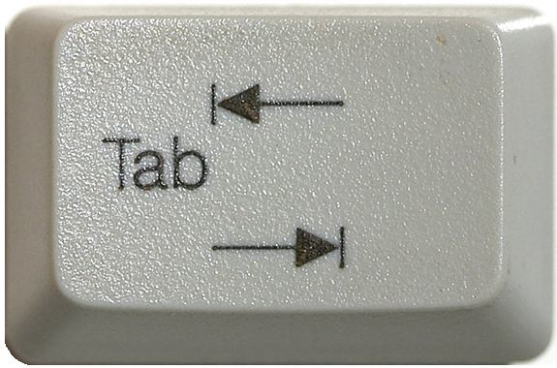

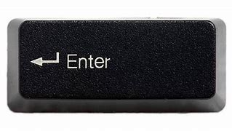
The metacharacters… easier or harder?
([0-9]|[a-zA-Z]|[!@$%&]|[ ]) → .
([0-9]|[a-zA-Z]|[!@$%&]|[ ]) → \d
([0-9]|[a-zA-Z]|[!@$%&]|[ ]) → \D
([0-9]|[a-zA-Z]|[!@$%&]|[ ]) → \w
([0-9]|[a-zA-Z]|[!@$%&]|[ ]) → \W
([0-9]|[a-zA-Z]|[!@$%&]|[ ]) → \s
([0-9]|[a-zA-Z]|[!@$%&]|[ ]) → \S
Newline goes in
this lane, right?
Depends. 🤷❓
Stay tuned for “flags”
Notes:
The period denotes a single character, including the period. Whether or not it includes the newline character depends on “flags,” which will be discussed later.
The “\d” metacharacter stands for the “digit” characters. Capitalizing to “\D” gives the inverse of this list: everything that is not a digit.
The “\w” metacharacter stands for “word” characters. Capitalizing to “\W” includes anything not found in a word
The “\s” metacharacter stands for “whitespace” characters. Capitalizing to “\S” includes anything not considered whitespace.

Slide 55
Basic REGEXP_<> syntax
char,
nchar,
varchar (MAX),
nvarchar (MAX)
<REGEXP_FUNC>(string_or_stringColumn
, RegExPtrn
)
Notes:
All RegExp functions apply to some string and will at least require a Regular Expression pattern.

Slide 56
Basic REGEXP_<> syntax
<REGEXP_FUNC>(string
, RegExPtrn
)
Notes:
All RegExp functions apply to some string and will at least require a Regular Expression pattern.

Slide 57
Basic REGEXP_<> syntax
<REGEXP_FUNC>(string
, RegExPtrn
, Param1
, Param2
, flags
, Param4
)
Notes:
All of them will also have one or more additional parameters, but they will have default values

Slide 58
Basic REGEXP_<> syntax
<REGEXP_FUNC>(string
, RegExPtrn
[, Param1 = 'default']
[, Param2 = 'default']
[, flags = 'default']
[, Param4 = 'default']
)
<REGEXP_FUNC>(string
, RegExPtrn
[, Param1 = 'default'
[, Param2 = 'default'
[, flags = 'default'
[, Param4 = 'default'
]
]
]
)
Notes:
The way SQL Server designed the function though, is the parameter ordering is very specific, since most of the values are numbers

Slide 59
Basic REGEXP_<> syntax
<REGEXP_FUNC>(string
, RegExPtrn
[, Param1 = 'default'
[, Param2 = 'default'
[, flags = 'default'
[, Param4 = 'default'
]
]
]
)
Notes:
For purposes of the presentation, I will show all parameters, but also grey them out to demonstrate that they are not required.

Slide 60
Basic REGEXP_<> syntax
<REGEXP_FUNC>(string
, RegExPtrn
[, Param1 = 'default'
[, Param2 = 'default'
[, flags = 'default'
[, Param4 = 'default'
]
]
]
)
Notes:
But this also brings up an interesting point. If I want to edit a parameter to a non-default value…

Slide 61
Basic REGEXP_<> syntax
<REGEXP_FUNC>(string
, RegExPtrn
, Param1 = 'default'
, Param2 = 'value'
[, flags = 'default'
[, Param4 = 'default'
]
)
Notes:
I have to explicitly request all preceding parameters and values before it

Slide 62
<REGEXP_FUNC>(stringable, RegExPtrn...[,flags='c'])
Flag | Mode | Description
i | Ignore case | Performs case-insensitive matching.
c | Default | Performs case-sensitive matching. (default)
s | “Dot-all” | Allows the period (.), to match the newline character (\n)
m | Multi-line | The function interprets the caret (^) and the dollar sign ($) as the start and end, respectively, of any line anywhere in the string, rather than only at the start or end of the entire string.
Notes:
Oracle uses very similarly-named functions. The s-flag is replaced by the n-character in Oracle.

Slide 63
Build some example data
CREATE TABLE dbo.Employees (
ID INT IDENTITY(101,1),
[Name] VARCHAR(150),
Email VARCHAR(320),
Phone_Number VARCHAR(20)
);
INSERT INTO dbo.Employees ([Name], Email, Phone_Number)
VALUES ('John Doe', 'john@contoso.com', '123-456-7890')
, ('Alice Smith', 'alice@fabrikam.com', '234-567-8901')
, ('Bob Johnson', 'bob@fabrikam.net','345-678-9012')
, ('Eve Jones', 'eve@contoso.com', '456-789-0123')
, ('Charlie Brown', 'charlie@contoso.co.in', '567-890-124');
Bad data
https://devblogs.microsoft.com/azure-sql/introducing-regular-expression-regex-support-in-azure-sql-db/

Slide 64
REGEXP_COUNT ( string, RegExPtrn [,startPos = 1 [,flags = 'c']] )
Returns the number of times a regular-expression pattern matches within a string
Old way: REPLACE + LEN
DECLARE @_find varchar(255) = 'in'
DECLARE @_inside varchar(255) = 'interesting'
SELECT @_inside AS original
, @_find AS [find_this]
, LEN(@_inside) AS [LEN(original)]
, REPLACE(@_inside, @_find, '') AS [replaced]
, LEN(REPLACE(@_inside, @_find, '')) AS [LEN(replaced)]
, (LEN(@_inside) - LEN(REPLACE(@_inside, @_find, ''))) / LEN(@_find) AS [Count]

Slide 65
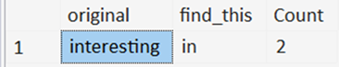
REGEXP_COUNT ( string, RegExPtrn [,startPos = 1 [,flags = 'c']] )
Returns the number of times a regular-expression pattern matches within a string
DECLARE @_find varchar(255) = 'in'
DECLARE @_inside varchar(255) = 'interesting'
SELECT @_inside AS original
, @_find AS [find_this]
, REGEXP_COUNT(@_inside,@_find,1,'c') AS [Count]
Notes:
Working with literals is boring

Slide 66
REGEXP_COUNT ( string, RegExPtrn [,startPos = 1 [,flags = 'c']] )
Returns the number of times a regular-expression pattern matches within a string
SELECT [Name]
, REGEXP_COUNT([Name],'[AEIOU]',1,'c') AS [COUNT(Name.Vowels[].Upper)]
, '|' AS '|'
, REGEXP_COUNT([Name],'[AEIOU]',1,'i') AS [COUNT(Name.Vowels[])]
, REGEXP_COUNT([Name],'[AaEeIiOoUu]') AS [COUNT(Name.Vowels[])]
, REGEXP_COUNT(UPPER([Name]),'[AEIOU]') AS [COUNT(Name.Vowels[])]
FROM dbo.Employees
Name | | | COUNT(Name.Vowels[].Upper) | COUNT(Name.Vowels[])
John Doe | | | 0 | 3
Alice Smith | | | 1 | 4
Bob Johnson | | | 0 | 3
Eve Jones | | | 1 | 4
Charlie Brown | | | 0 | 4

Slide 67
REGEXP_LIKE(string, RegExPtrn [,flags='c'])
Determines if a string matches a regular expression.
Not available to the SELECT clause, only the WHERE clause.
Old way: (LIKE + OR)ⁿ
SELECT ID, Phone_Number
FROM dbo.Employees
WHERE Phone_Number LIKE '456-%'
SELECT ID, Phone_Number
FROM dbo.Employees
WHERE Phone_Number
LIKE '[0-9][0-9][0-9]-[0-9][0-9][0-9]-9012'
OR Phone_Number
LIKE '[0-9][0-9][0-9]-[0-9][0-9][0-9]-0123'
ID | Phone_Number
104 | 456-789-0123
ID | Phone_Number
103 | 345-678-9012
104 | 456-789-0123

Slide 68
REGEXP_LIKE(string, RegExPtrn [,flags='c'])
Determines if a string matches a regular expression.
Not available to the SELECT clause, only the WHERE clause.
SELECT ID, Phone_Number
FROM dbo.Employees
WHERE REGEXP_LIKE(Phone_Number, '^456-')
SELECT ID, Phone_Number
FROM dbo.Employees
WHERE REGEXP_LIKE(Phone_Number
, '^\d{3}-\d{3}-(9012|0123)$')
ID | Phone_Number
104 | 456-789-0123
ID | Phone_Number
103 | 345-678-9012
104 | 456-789-0123

Slide 69
REGEXP_LIKE(string, RegExPtrn [,flags='c'])
Determines if a string matches a regular expression
Not available to the SELECT clause, only the WHERE clause.
-- Add constraint with table creation
CREATE TABLE Employees (
ID INT IDENTITY(101,1)
, [Name] VARCHAR(150)
, Email VARCHAR(320)
CHECK ( REGEXP_LIKE(Email,'^[A-Za-z0-9._%+-]+@[A-Za-z0-9.-]+\.[A-Za-z]{2,}$') )
, Phone_Number VARCHAR(20)
CHECK ( REGEXP_LIKE(Phone_Number, '^\d{3}-\d{3}-\d{4}$') )
);
-- Add constraint after table creation
ALTER TABLE Employees
ADD CONSTRAINT Phone_Validation
CHECK ( REGEXP_LIKE(Phone_Number, '^\d{3}-\d{3}-\d{4}$') )
Notes:
REGEXP_LIKE can also be used in a CHECK constraint to enforce a pattern

Slide 70
CASE/WHEN/THEN[/ELSE]/END
Allows conditional logic within queries, enabling different outputs based on specified conditions
SELECT Phone_Number
, CASE WHEN Phone_Number LIKE
'[0-9][0-9][0-9]-[0-9][0-9][0-9]-[0-9][0-9][0-9][0-9]'
THEN '(Valid)'
ELSE ''
END AS isValid
FROM dbo.Employees
Correct syntax
SELECT Phone_Number
, CASE WHEN
REGEXP_LIKE(Phone_Number, '\d{3}-\d{3}-\d{4}')
THEN '(Valid)'
ELSE ''
END AS isValid
FROM Employees
Correct syntax
Notes:
REGEXP_LIKE is available in the CASE/WHEN/THEN/ELSE/END phrase, but requires a more special syntax placement than before

Slide 71
REGEXP_INSTR (string, RegExPtrn [,startPos = 1 [,occurrence = 1
[,return_option = 0 [,flags = 'c']]]] )
Returns the starting/ending position (based on return_option), of the nᵗʰ occurrence of a regular expression pattern, found within a string.
SELECT Email
, REGEXP_INSTR(email,'@' , 1, 1, 0) AS [1st_At]
, REGEXP_INSTR(email,'co', 1, 2, 0) AS [2nd_co_Start]
, REGEXP_INSTR(email,'co', 1, 2, 1) AS [2nd_co_End]
FROM Employees
Occurrence is the numerical (nth) instance of the pattern found
Return_option = 0 returns the beginning position where the pattern matched.
Return_option = 1 returns the position where the pattern ended.
Email | 1st_At | 2nd_co_Start | 2nd_co_End
john@contoso.com | 5 | 14 | 16
alice@fabrikam.com | 6 | 0 | 0
bob@fabrikam.net | 4 | 0 | 0
eve@contoso.com | 4 | 13 | 15
charlie@contoso.co.in | 8 | 17 | 19

Slide 72
Demo
● REGEXP_COUNT
● REGEXP_LIKE
● REGEXP_INSTR

Slide 73
Sub-expressions
SELECT ID, Phone_Number
FROM dbo.Employees
WHERE REGEXP_LIKE(Phone_Number
, '^\d{3}-\d{3}-(9012|0123)$' )
(9012|0123)
Notes:
Earlier while talking about REGEXP_LIKE, we saw the use of parenthesis.
We used them to “wall-off” a list of acceptable values within a certain portion of the pattern.
The pattern contained within parenthesis is called a sub-expression.

Slide 74
Sub-expressions
SELECT ID, Phone_Number
FROM dbo.Employees
WHERE REGEXP_LIKE(Phone_Number
, '^(\d{3})-(\d{3})-(9012|0123)$' )
\1 \2 \3
Notes:
And we can wall-off anything inside a regular expression, even it leaves one option within.

Slide 75
REGEXP_REPLACE ( string, RegExPtrn, withPattern [, startPos = 1 [, ordinal = 0 [, flags = 'c']]] )
Returns an in-string replacement of a regular expression pattern, with another regular expression pattern.
SELECT Phone_Number
, REGEXP_REPLACE
( Phone_Number, '(\d{3})-(\d{3})-(\d{4})' , '(\1) \2-\3' )
AS Pretty_Format
FROM Employees
Phone_Number | Pretty_Format
123-456-7890 | (123) 456-7890
234-567-8901 | (234) 567-8901
345-678-9012 | (345) 678-9012
456-789-0123 | (456) 789-0123
567-890-1234 | 567-890-124
Ordinal is the numerical instance of the pattern found. If 0, then apply to every instance found. If n, only apply to the nth instance found.
Notes:
Using REGEXP_REPLACE, we can redecorate data using sub-expressions.
Sub-expressions are numbered based on their creation from left-to-right
SQL Server only supported numbered expressions at this time.
If the data does not meet the criteria of the regular expression, it is returned with no modifications.

Slide 76
REGEXP_REPLACE ( string, RegExPtrn, withPattern [, startPos = 1 [, ordinal = 0 [, flags = 'c']]] )
Returns an in-string replacement of a regular expression pattern, with another regular expression pattern.
SELECT Phone_Number
, REGEXP_REPLACE
( Phone_Number, '(\d{3})-(\d{3})-(\d{4})' , '(XXX) XXX-\3' )
AS DataMask
FROM Employees
Phone_Number | DataMask
123-456-7890 | (XXX) XXX-7890
234-567-8901 | (XXX) XXX-8901
345-678-9012 | (XXX) XXX-9012
456-789-0123 | (XXX) XXX-0123
567-890-1234 | 567-890-124
Notes:
Here, we’re only using the last four digits of the phone number.

Slide 77
REGEXP_SUBSTR (string, RegExPtrn [,startPos = 1 [,occurrence = 1
[,flags = 'c' [,whichSubExp = 0]]]] )
Returns a substring -- matching a regular expression pattern -- found within a string
SELECT Email
, REGEXP_SUBSTR(email, '@.+$' , 1, 1, 'c', 0) AS Suffix_Ver1
, REGEXP_SUBSTR(email, '@(.+)$', 1, 1, 'c', 0) AS Suffix_Ver2
, REGEXP_SUBSTR(email, '@(.+)$', 1, 1, 'c', 1) AS Domain
FROM Employees
Email | Suffix_Ver1 | Suffix_Ver2 | Domain
john@contoso.com | @contoso.com | @contoso.com | contoso.com
alice@fabrikam.com | @fabrikam.com | @fabrikam.com | fabrikam.com
bob@fabrikam.net | @fabrikam.net | @fabrikam.net | fabrikam.net
eve@contoso.com | @contoso.com | @contoso.com | contoso.com
charlie@contoso.co.in | @contoso.co.in | @contoso.co.in | contoso.co.in
Notes:
Adding parenthesis in a regular expression pattern create sub-expressions. But they have no value unless you call a non-zero expression to return.
In the case of REGEXP_SUBSTR, sub-expressions can be used to extract substrings of substrings.

Slide 78
Demo
● REGEXP_REPLACE
● REGEXP_SUBSTR

Slide 79
Flags revisited…
Flag | Mode | Description
i | Ignore case | Performs case-insensitive matching.
c | Default | Performs case-sensitive matching. (default)
s | “Dot-all” | Allows the period (.), to match the newline character (\n)
m | Multi-line | The function interprets the caret (^) and the dollar sign ($) as the start and end, respectively, of any line anywhere in the string, rather than only at the start or end of the entire string.
Notes:
Oracle uses very similarly-named functions. The s-flag is replaced by the n-character in Oracle.

Slide 80
Flags revisited…
Mixed-casing within multi-line
SELECT REGEXP_COUNT('this is a line
This is another line
Third line', '^Thi' [,...]) AS [Count]
Multi-line
[,...])
Line starts with “Thi”
Flags go here…

Slide 81
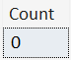
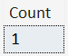
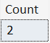
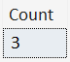
Flags revisited…
SELECT REGEXP_COUNT('this is a line
This is another line
Third line', '^Thi', 1, 'sc') AS [Count]
SELECT REGEXP_COUNT('this is a line
This is another line
Third line', '^Thi', 1, 'si') AS [Count]
SELECT REGEXP_COUNT('this is a line
This is another line
Third line', '^Thi', 1, 'mc') AS [Count]
SELECT REGEXP_COUNT('this is a line
This is another line
Third line', '^Thi', 1, 'mi') AS [Count]

Slide 82
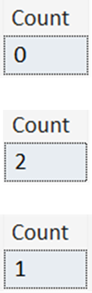
Flags revisited…
SELECT REGEXP_COUNT('Hello World
hello universe
HELLO AGAIN!
hello multi-line match!'
, '^hello.*$', 1, 's') AS [Count]
SELECT REGEXP_COUNT('Hello World
hello universe
HELLO AGAIN!
hello multi-line match!'
, '^hello.*$', 1, 'm') AS [Count]
SELECT REGEXP_COUNT('Hello World
hello universe
HELLO AGAIN!
hello multi-line match!'
, '^hello.*$', 1, 'ms') AS [Count]
Notes:
The m and s flags are not mutually exclusive: they can be combined.

Slide 83
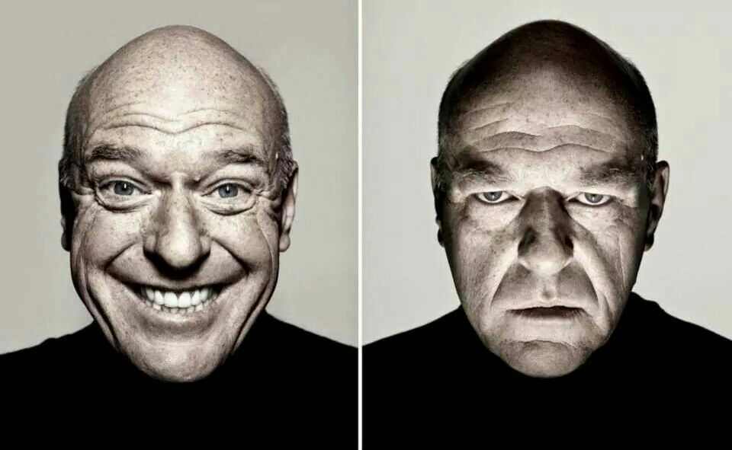
Closing Thoughts…
Developer
DBA

Slide 84
Demo
https://regex101.com/
Four score and seven years ago our fathers brought forth, upon this continent, a new nation, conceived in liberty, and dedicated to the proposition that all men are created equal.
Now we are engaged in a great civil war, testing whether that nation, or any nation so conceived, and so dedicated, can long endure. We are met on a great battle field of that war. We come to dedicate a portion of it, as a final resting place for those who died here, that the nation might live. This we may, in all propriety do.

Slide 85
Performance
SELECT [Name], Email, REGEXP_INSTR(email, '@') AS [Position_of_@]
FROM Employees
WHERE REGEXP_INSTR(email, '@') > 0
SELECT [Name], Email, CHARINDEX('@', email ) AS [Position_of_@]
FROM Employees
WHERE Email LIKE '%@%'

Slide 86
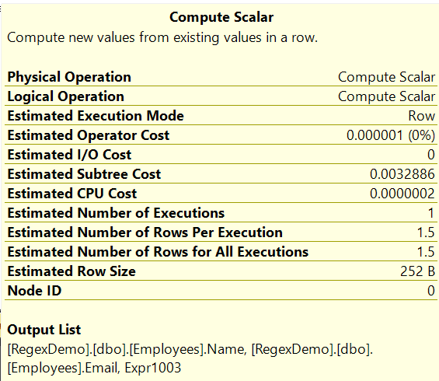

Performance
SELECT [Name], Email, REGEXP_INSTR(email, '@') AS [Position_of_@]
FROM Employees
WHERE REGEXP_INSTR(email, '@') > 0
SELECT [Name], Email, CHARINDEX('@', email ) AS [Position_of_@]
FROM Employees
WHERE Email LIKE '%@%'
Query 1 (relative to the batch): 50% Query 2 (relative to the batch): 50%

Slide 87

Computed Column
ALTER TABLE dbo.Employees
ADD c_Email_Like_@ AS Convert(bit, CHARINDEX('@', Email)) PERSISTED
, c_Email_@_Position AS CHARINDEX('@', Email) PERSISTED
, c_Email_Substring AS SUBSTRING(Email, 8, 1) PERSISTED

Slide 88

Computed Column
ALTER TABLE dbo.Employees
ADD c_Email_Like_@ AS CONVERT(bit, CHARINDEX('@', Email)) PERSISTED
, c_Email_@_Position AS CHARINDEX('@', Email) PERSISTED
, c_Email_Substring AS SUBSTRING(Email, 8, 1) PERSISTED
SELECT [ID]
, [Email]
, [c_Email_Like_@]
, [c_Email_@_Position]
, [c_Email_Substring]
FROM [dbo].[Employees]
WHERE [c_Email_Like_@] = 1
OR [c_Email_@_Position] > 0
OR [c_Email_Substring] = '@'

Slide 89


SSMS Find/Replace

Slide 90

SSMS Find/Replace
(Find box)
(Replace box)
●
●
●
Match Case: Denotes if a case-sensitive search is performed for the subject
Match Whole Word: Denotes if additional alphabetic characters leading or
trailing the subject voids the result
Preserve Case: On replacement, maintain the original casement of the subject
(lowercase, UPPERCASE, Proper Case)

Slide 91
SSMS Find/Replace
(Find box)
(Replace box)
●
Regex Mode: Interprets the Find/Replace boxes as Regular Expression directives

Slide 92
Demo
SSMS – Find/Replace in Regex Mode

Slide 93





SSMS Find/Replace
^(.*)\t(.*)\t(.*)\t([^\r]*)$
,($1,'$2','$3','$4')
(Minor manual clean-up)
Notes:
$ only matches \n (newline), not \r (carriage return).
Thanks to Erin Stellato at Microsoft for help with this.

Slide 94

SSMS Find/Replace
^(.*)\t([^\r]*)$
EXEC sp @a='$1', @b='$2'\nGO
Notes:
$ only matches \n (newline), not \r (carriage return).
Thanks to Erin Stellato at Microsoft for help with this.

Slide 95
Where do we go from here?
Learned more than just % for LIKE
Scratched the surface on Regular Expression syntax
Introduced to the REGEXP functions
● REGEXP_COUNT()
● REGEXP_LIKE()
● REGEXP_INSTR()
● REGEXP_REPLACE()
● REGEXP_SUBSTR()
Experienced the Regex mode of SSMS Find/Replace

Slide 96
Jeff Foushee
SQL Server Database Admin
Programmer
SQL Saturday speaker
Blackjack dealer
https://www.linkedin.com/in/jeff-foushee/
https://github.com/jbfoushee/MyPresentations/

Slide 97

Advanced T-SQL Pattern Matching: Leveraging LIKE and Regular Expressions
https://github.com/jbfoushee/MyPresentations/

